Slide 1


:
Facial Emotion Recognition
Name- Abhinav Vikram Singh
Enroll. No. – S24CSEU1759
Name – Arnav Singh
Enroll. No. – S24CSEU1770

Slide 2

Problem Statement
The goal of this project is to automatically detect human emotions from face images.
The system should correctly classify emotions like angry, disgust, fear, happy, neutral, sad, and surprise.
This solves the need for a fast and reliable emotion recognition system that can be used in real-time applications such as education, security, and user-interaction systems.

Slide 3
PROPOSED SOLUTION
Use the FER2013 dataset for training and testing.
Build a model using MobileNetV2 with transfer learning.
Resize all images to 224 × 224.
Apply class weights to handle class imbalance.
Support real-time emotion detection using OpenCV face detection (Haar or DNN).

Slide 4


GOALS AND OBJECTIVES
Build a lightweight and accurate FER model.
Achieve high test accuracy (>70%)
Ensure the system works in real time on webcam.
Improve the base model using fine-tuning.
Provide smooth predictions to avoid flickering during webcam use.
ategories
Empowering Users
Incorporating AI

Slide 5
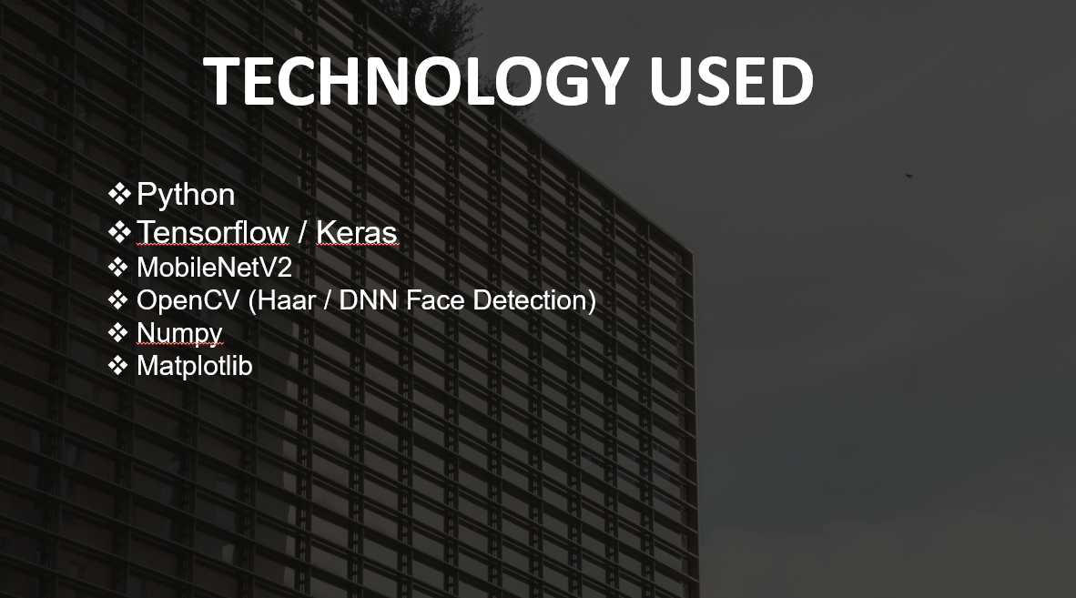

TECHNOLOGY USED
OOPs Cots
Python
Python
Vectors
Github

Slide 6
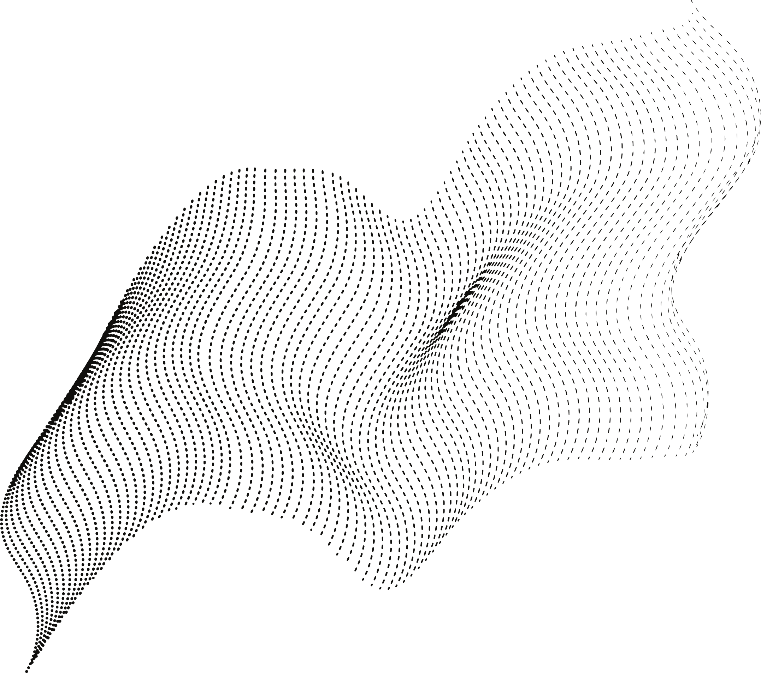
Detects 7 emotions from face images.
Uses transfer learning for better accuracy.
Lightweight model for fast inference.
Works live on webcam.
KEY FEATURES
Smoothened predictions using probability averaging.
Two face detection options: DNN or Haar Cascade.
.

Slide 7
Future Prospects
Replace Haar Cascade with RetinaFace or MTCNN for better detection
Convert the model to TensorFlow Lite for mobile deployment.
Increase dataset size and add stronger augmentations.
Build a clean GUI for easier use.
Add real-time analytics or emotion-based applications.

Slide 8
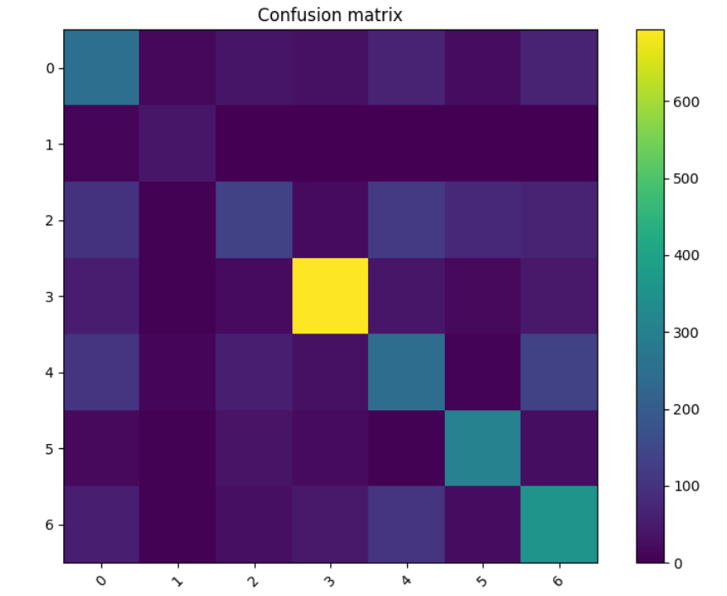
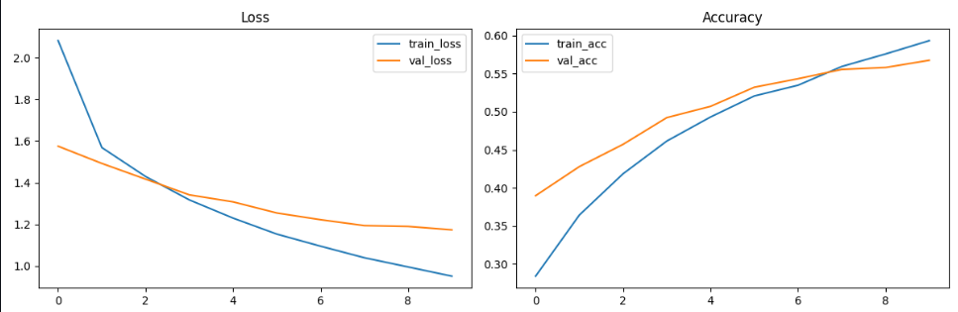
KEY RESULTS
Test Accuracy: 70.58%
Macro F1-Score: 55%
Confusion matrix shows that similar emotions (like fear & surprise) are sometimes mixed.
Training history shows the model improves after fine-tuning.

Slide 9
Thank You!

